Slide 1

Chapter 9
Introduction
To
Data-Link
Layer
Copyright © The McGraw-Hill Companies, Inc. Permission required for reproduction or display.
Notes:
1

Slide 2
Chapter 9: Outline
9.1 INTRODUCTION
9.2 LINK-LAYER ADDRESSING
Notes:
9.#

Slide 3

Chapter 9: Objective
The first section introduces the data-link layer. It starts with defining the concept of links and nodes. The section then lists and briefly describes the services provided by the data-link layer. It next defines two categories of links: point-to-point and broadcast links. The section finally defines two sub-layers at the data-link layer that will be elaborated on in the next few chapters.
The second section discusses link-layer addressing. It first explains the rationale behind the existence of an addressing mechanism at the data-link layer. It then describes three types of link-layer addresses. The section discusses the Address Resolution Protocol (ARP), which maps the addresses at the network layer to addresses at the data-link layer.
Notes:
9.#

Slide 4
9-1 INTRODUCTION
The Internet is a combination of networks glued together by connecting devices (routers or switches). If a packet is to travel from a host to another host, it needs to pass through these networks. Figure 9.1 shows the same scenario we discussed in Chapter 3, but we are now interested in communication at the data-link layer.
9.4
Notes:
9.#

Slide 5
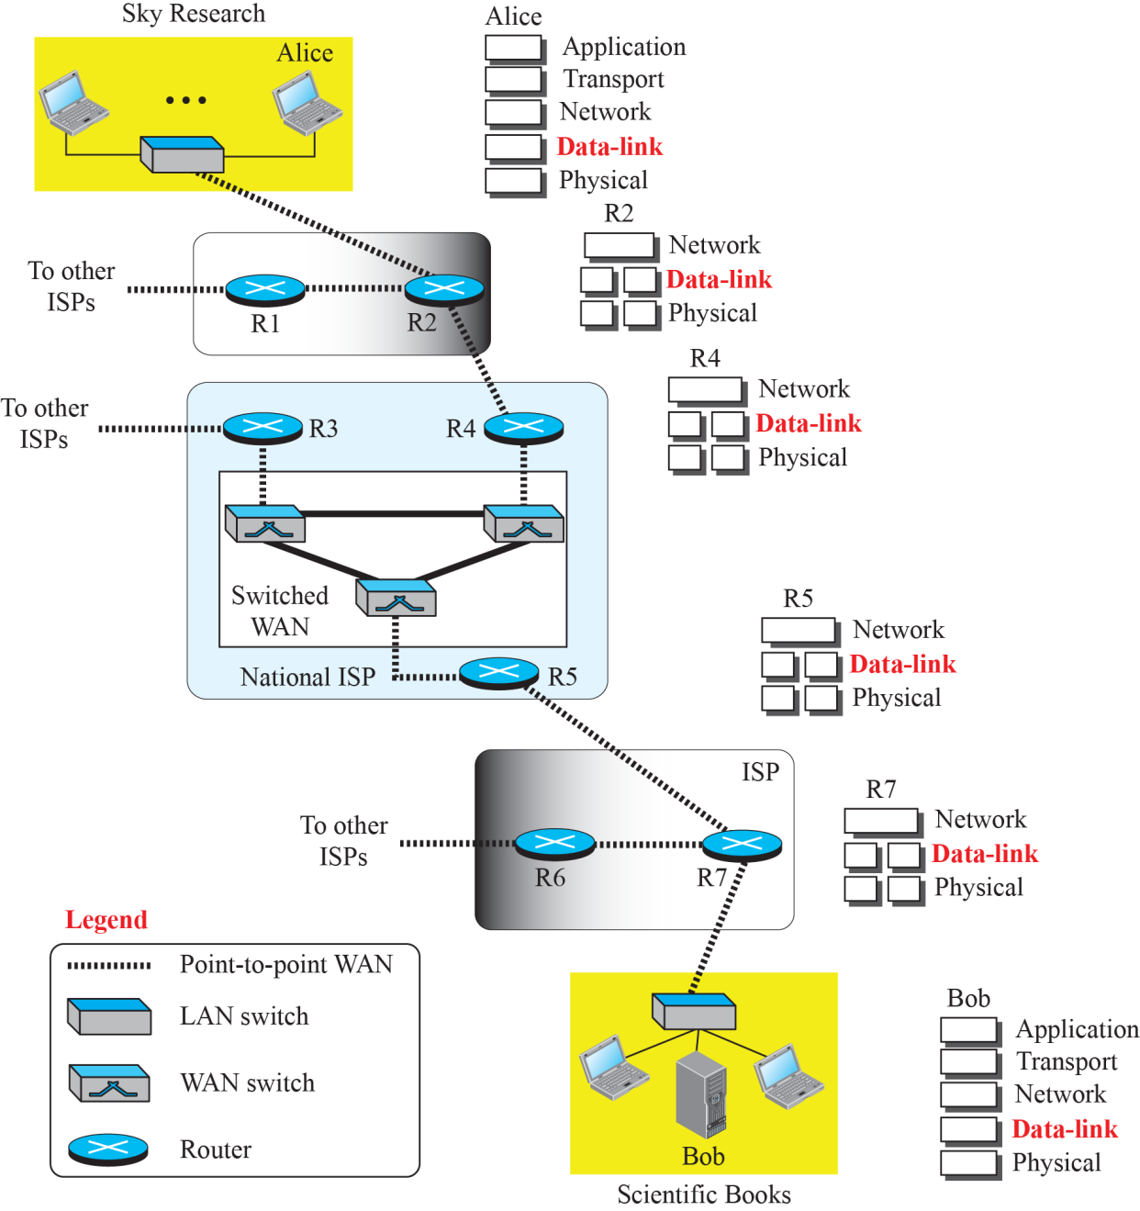
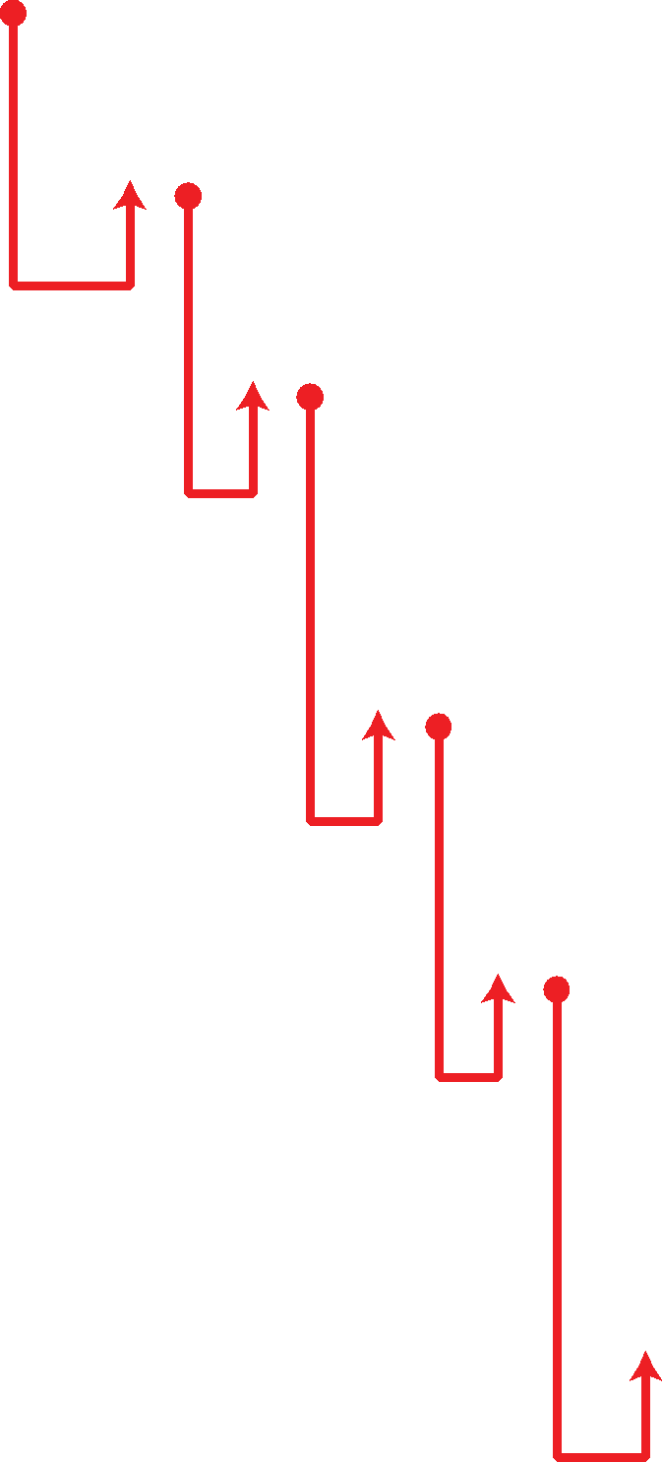
Figure 9.1: Communication at the data-link layer
9.5
Notes:
9.#

Slide 6
9.9.1 Nodes and Links
Communication at the data-link layer is node-to-node. A data unit from one point in the Internet needs to pass through many networks (LANs and WANs) to reach another point. Theses LANs and WANs are connected by routers. It is customary to refer to the two end hosts and the routers as nodes and the networks in between as links. Figure 9.2 is a simple representation of links and nodes when the path of the data unit is only six nodes.
9.6
Notes:
9.#

Slide 7
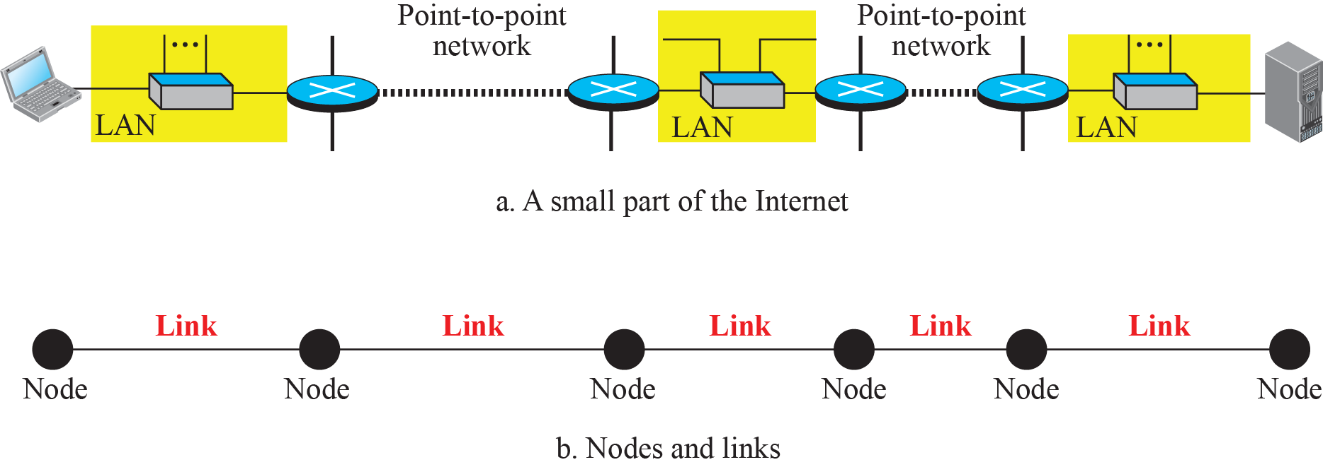
Figure 9.2: Nodes and Links
9.7
Notes:
9.#

Slide 8
9.9.2 Services
The data-link layer is located between the physical and the network layers. The data-link layer provides services to the network layer; it receives services from the physical layer. Let us discuss services provided by the data-link layer.
9.8
Notes:
9.#

Slide 9

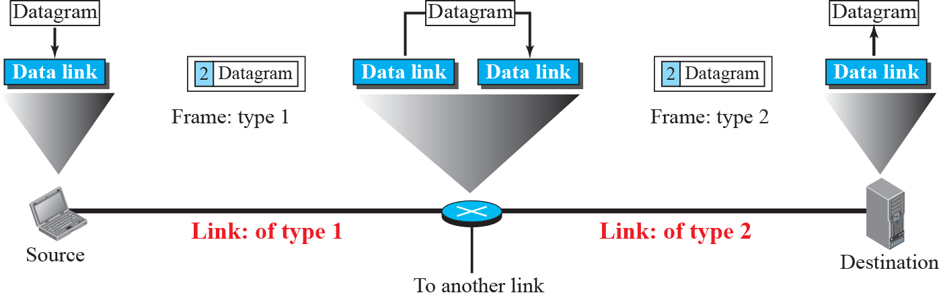
Figure 9.3: A communication with only three nodes
9.9
Notes:
9.#

Slide 10
9.9.3 Two Categories of Links
Although two nodes are physically connected by a transmission medium such as cable or air, we need to remember that the data-link layer controls how the medium is used. We can have a data-link layer that uses the whole capacity of the medium; we can also have a data-link layer that uses only part of the capacity of the link. In other words, we can have a point-to-point link or a broadcast link.
9.10
Notes:
9.#

Slide 11
9.9.4 Two Sublayers
To better understand the functionality of and the services provided by the link layer, we can divide the data-link layer into two sublayers: data link control (DLC) and media access control (MAC). This is not unusual because, as we will see in later chapters, LAN protocols actually use the same strategy.
9.11
Notes:
9.#

Slide 12
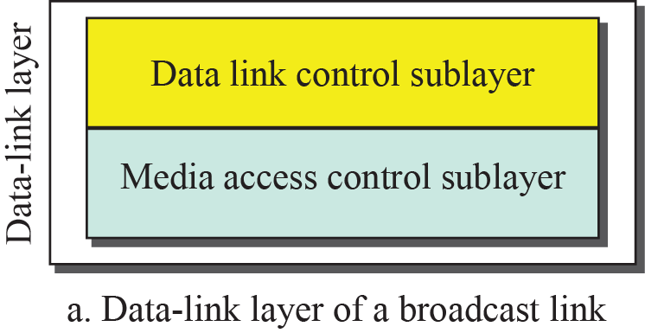
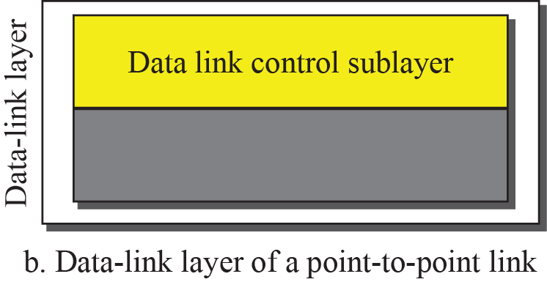
Figure 9.3: Dividing the data-link layer into two sublayers
Broadcast:-DLC,MAC
Point to Point:-DLC
9.12
Notes:
9.#

Slide 13
5-4 LINK-LAYER ADDRESSING
In Chapter 18, we will discuss IP addresses as the identifiers at the network layer. However, in a internetwork such as the Internet we cannot make a datagram reach its destination using only IP addresses. The source and destination IP addresses define the two ends but cannot define which links the packet should pass through.
9.13
Notes:
9.#

Slide 14
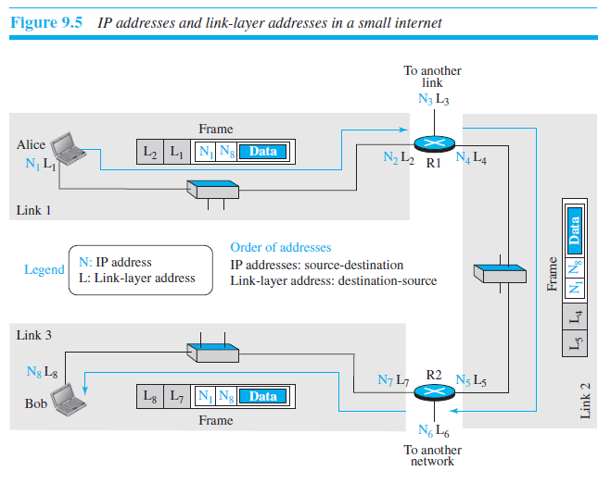
Figure 9.5: IP addresses and link-layer addresses in a small internet
9.14
Notes:
9.#

Slide 15
9.2.1 Three Types of addresses
Some link-layer protocols define three types of addresses: unicast, multicast, and broadcast.
9.15
Notes:
9.#

Slide 16
Example 9.1
As we will see in Chapter 13, the unicast link-layer addresses in the most common LAN, Ethernet, are 48 bits (six bytes) that are presented as 12 hexadecimal digits separated by colons; for example, the following is a link-layer address of a computer. The second digit needs to be an odd number.
A3:34:45:11:92:F1
8 bit each
9.16
Notes:
16

Slide 17
Example 9.2
As we will see in Chapter 13, the multicast link-layer addresses in the most common LAN, Ethernet, are 48 bits (six bytes) that are presented as 12 hexadecimal digits separated by colons. The second digit, however, needs to be an even number in hexadecimal. The following shows a
multicast address:
A2:34:45:11:92:F1
9.17
Notes:
17

Slide 18
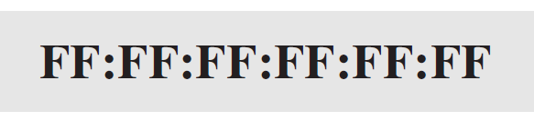
Example 9.3
As we will see in Chapter 13, the broadcast link-layer addresses in the most common LAN, Ethernet, are 48 bits, all 1s, that are presented as 12 hexadecimal digits separated by colons. The following shows a broadcast address:
9.18
Notes:
18

Slide 19
9.2.2 ARP
Anytime a node has an IP datagram to send to another node in a link, it has the IP address of the receiving node. However, the IP address of the next node is not helpful in moving a frame through a link; we need the link-layer address of the next node. This is the time when the Address Resolution Protocol (ARP) becomes helpful.
9.19
Notes:
9.#

Slide 20
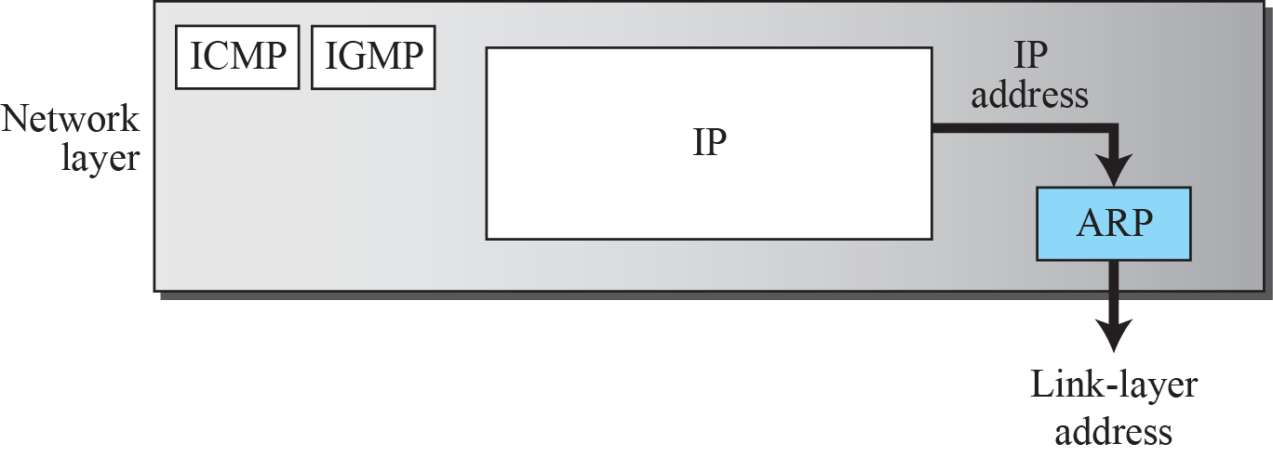
Figure 9.6: Position of ARP in TCP/IP protocol suite
ICMP=Internet control message protocol
IGMP=Internet group management protocol
9.20
Notes:
9.#

Slide 21
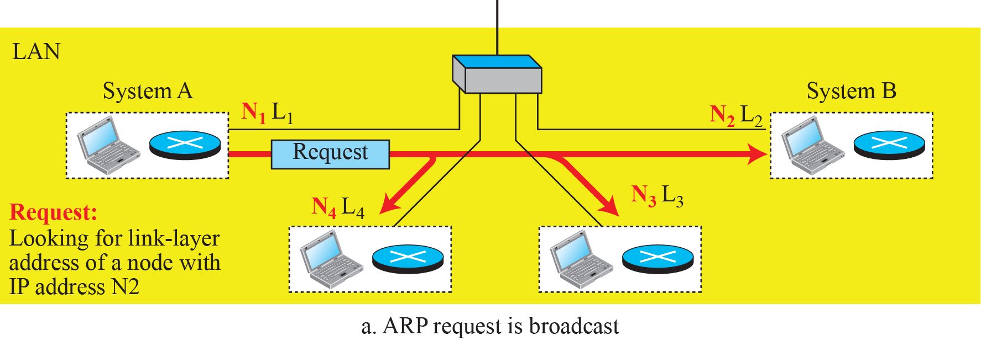
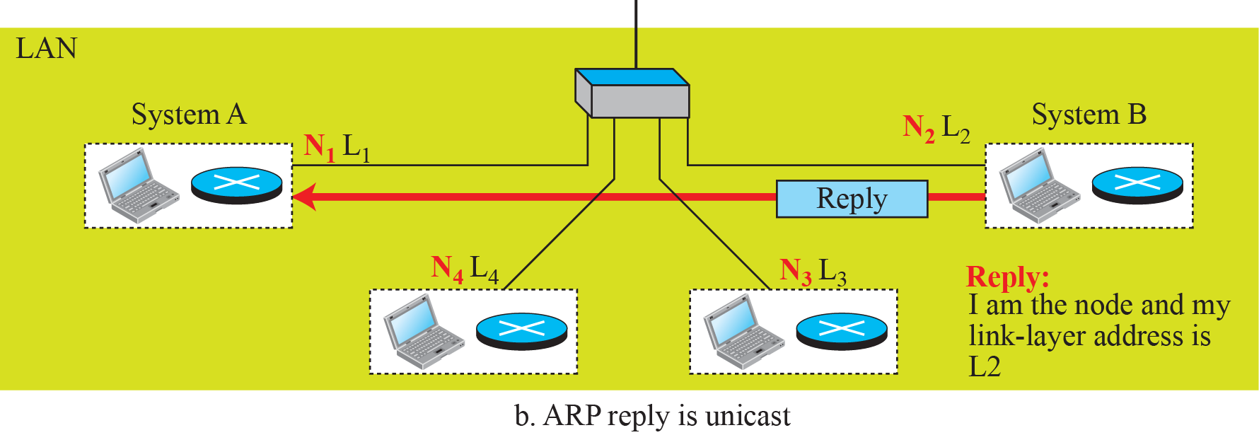
Figure 9.7: ARP operation
9.21
Notes:
9.#

Slide 22
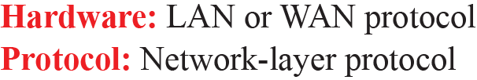
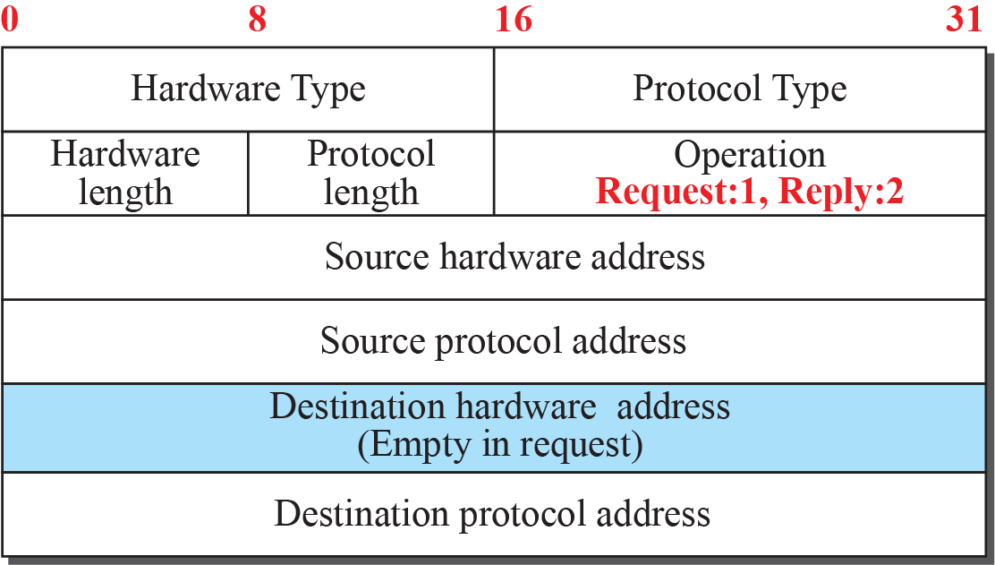
Figure 9.8: ARP packet
9.22
Notes:
9.#

Slide 23
Example 9.4
A host with IP address N1 and MAC address L1 has a packet to send to another host with IP address N2 and physical address L2 (which is unknown to the first host). The two hosts are on the same network. Figure 9.9 shows the ARP request and response messages.
A don’t’t know the mac address of B i.e hardware address
9.23
Notes:
23

Slide 24
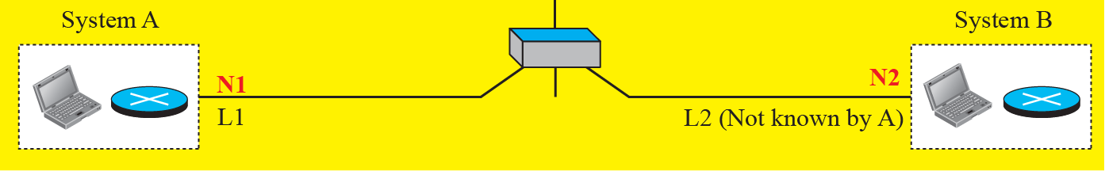
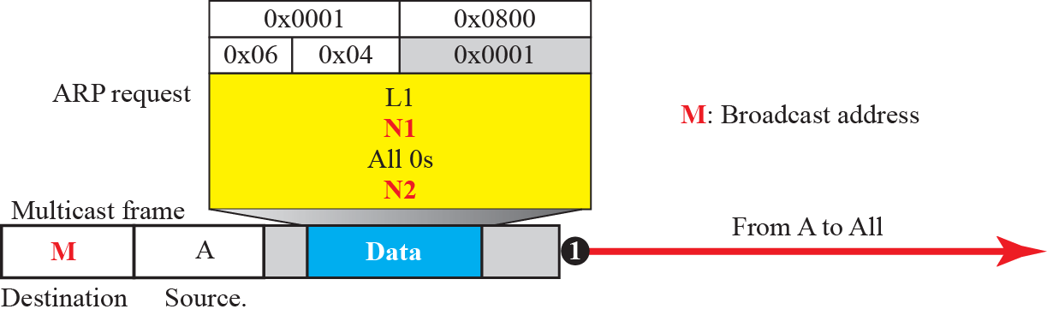
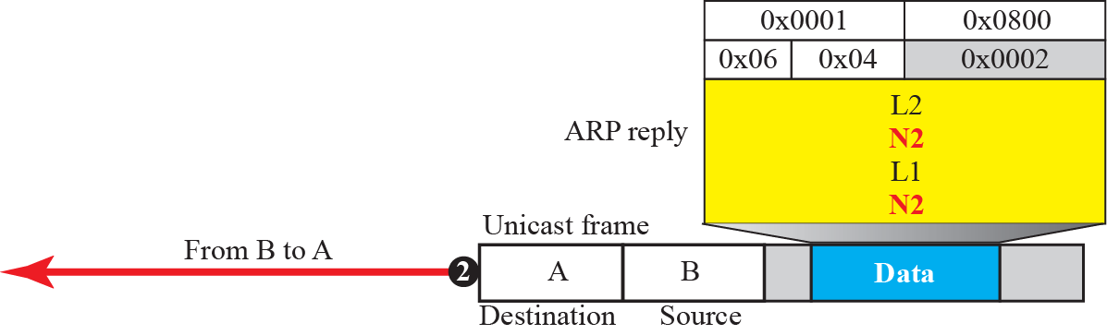
Figure 9.9: Example 9.4
9.24
Notes:
9.#

Slide 25
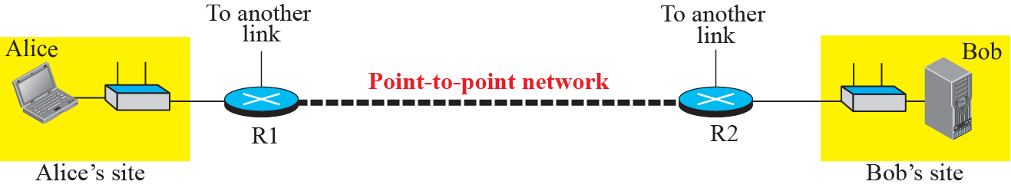
Figure 9.10: The internet for our example
9.25
Notes:
9.#

Slide 26
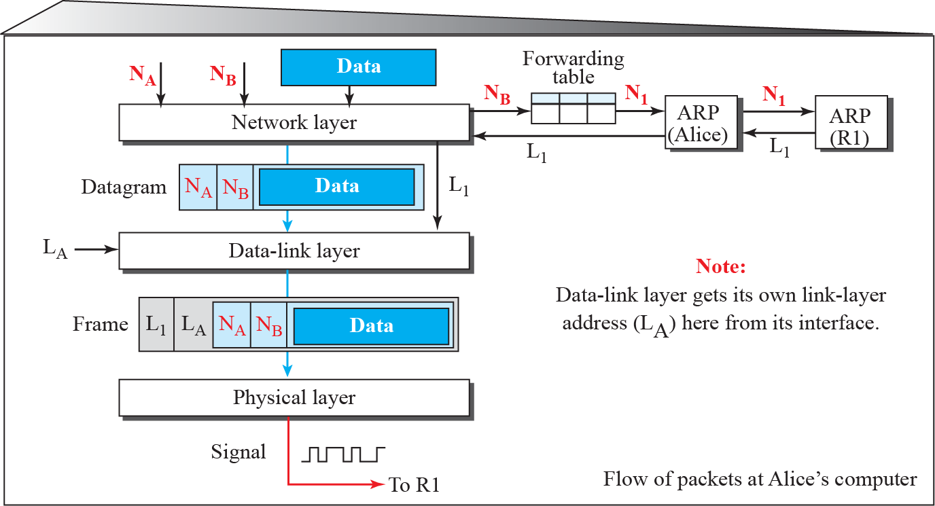
Figure 9.11: Flow of packets at Alice site
9.26
Notes:
9.#

Slide 27
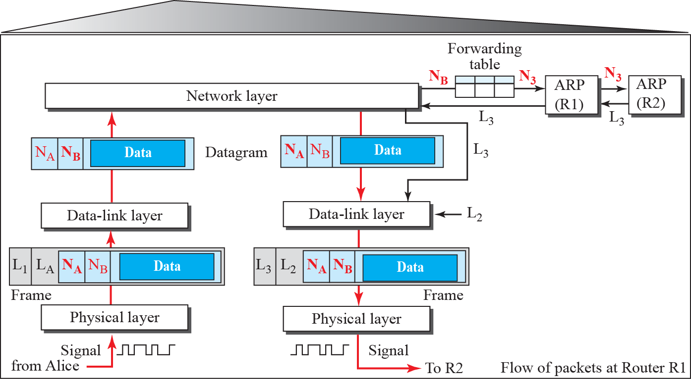
Figure 9.12: Flow of activities at router R1
9.27
Notes:
9.#

Slide 28
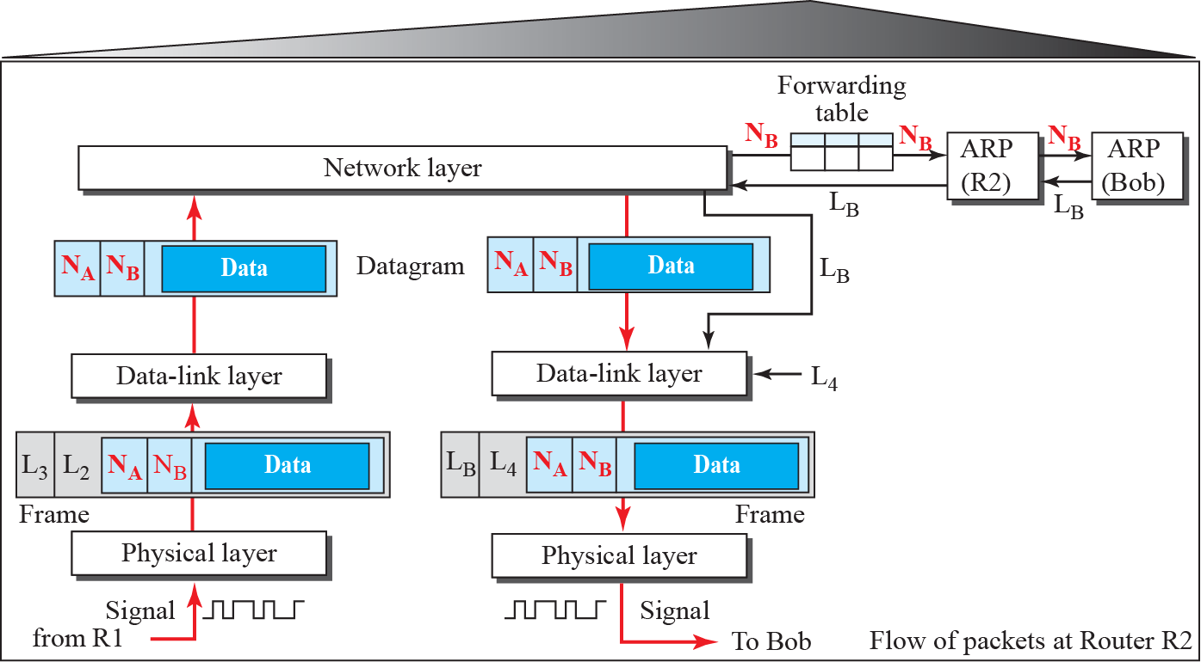
Figure 9.13: Flow of activities at router R2
9.28
Notes:
9.#

Slide 29
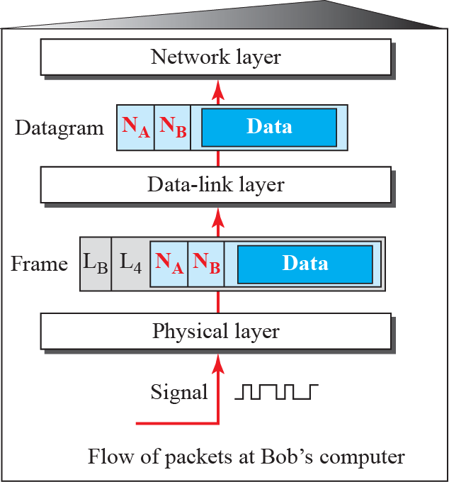
Figure 9.14: Activities at Bob’s site
9.29
Notes:
9.#

